Slide 1
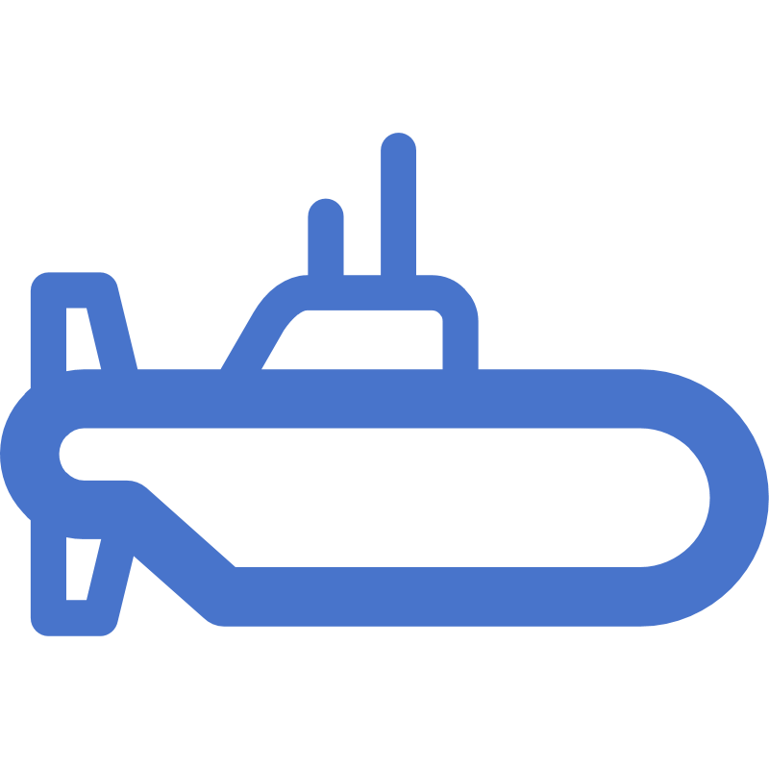




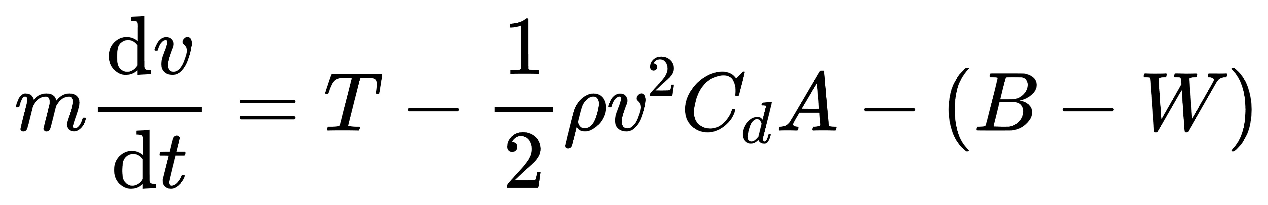



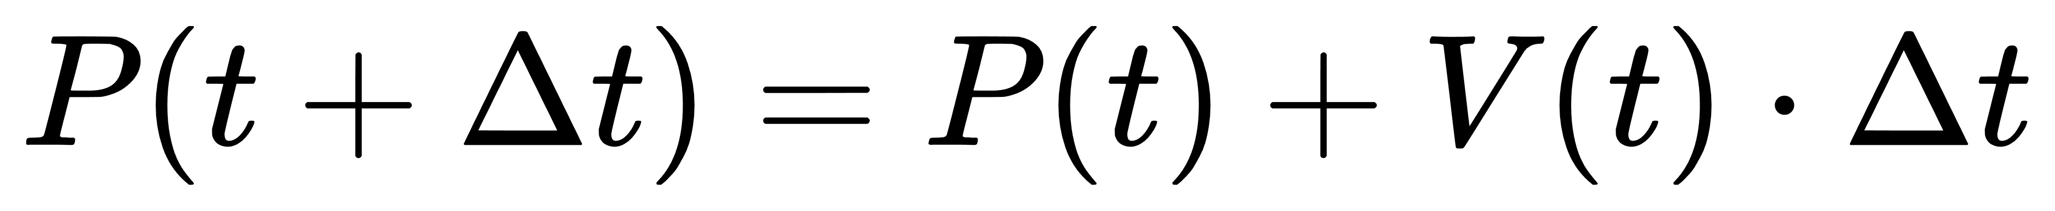


Submarine Location Predict Model
Initial Model Establishment
Particle Tracking
Fluid Dynamics Equations
Submersible Motion Equations
Ocean Current Data
Particle Tracking Equations
LSTM
Prediction
LSTM Model
LSTM Model Training
Output a Dense Layer
Data Preprocessing
Model Improvements
xarray.Dataset { dimensions:
time = 1 ;
year = 1 ;
depth = 1 ;
latitude = 481 ;
longitude = 1201 ;
……
model = Sequential([
LSTM(50, input_shape= (X.shape[1], X.shape[2])),
Dense(1)])
model.compile(optimizer='adam', loss='mean_squared_error')
Input
Layer
…
Output
Layer
Data Normalization
Result Prediction
50 Cell LSTM
Hidden Layer
scaler = MinMaxScaler(feature_range=(0, 1))
scaled_data = scaler.fit_transform(data)
print(Predicted Submarine Position)
Result

Slide 2










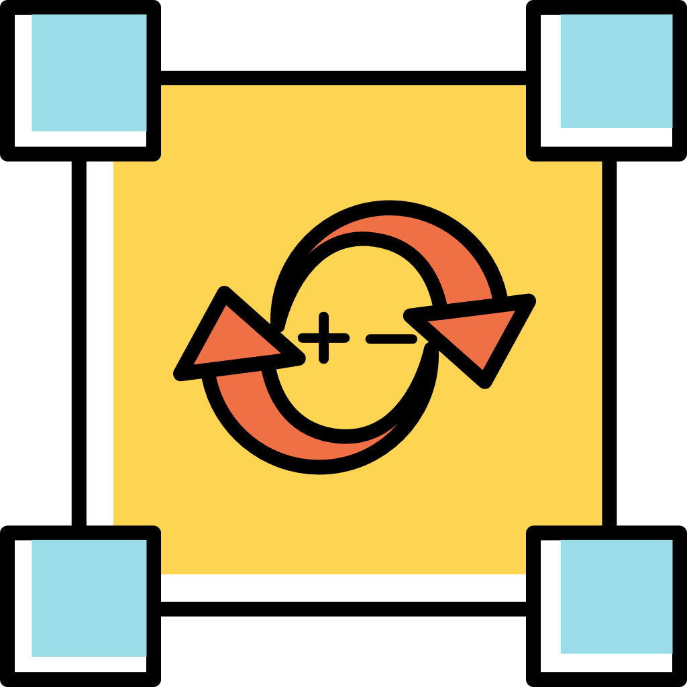

Submarine Location Predict Model
Initial Model Establishment
Particle Tracking
Fluid Dynamics Equations
Submersible Motion Equations
Current
Direction
Current
Speed
Latitude
Longitude
Particle Tracking Equations
LSTM
Prediction
Equations Application
Ocean Current Data
LSTM Model
LSTM Model Training
Output Dense Layer
Data Preprocessing
Model Improvements
Kalman Filter
time = 1 ;
xarray.Dataset { dimensions:
time = 1 ;
year = 1 ;
depth = 1 ;
latitude = 481 ;
longitude = 1201 ; }
model = Sequential([
LSTM(50, input_shape= (X.shape[1], X.shape[2])),
Dense(1)])
model.compile(optimizer='adam', loss='mean_squared_error')
Seawater Density Anomaly
(RHOAnoma)
Hydrostatic Pressure Anomaly
(PHIHYD)
Density Stratification
(DRHODR)
Input
Layer
…
Output
Layer
Data Normalization
Evaluation
Root Mean
Square Error
scaler = MinMaxScaler (feature_range=(0, 1))
scaled_data =
scaler.fit_transform(data)
Result Prediction
Observation Matrix
State Transition Matrix
Noise Covariance
print(Predicted Submarine Position)
50 Cell LSTM
Hidden Layer
Result

Slide 3
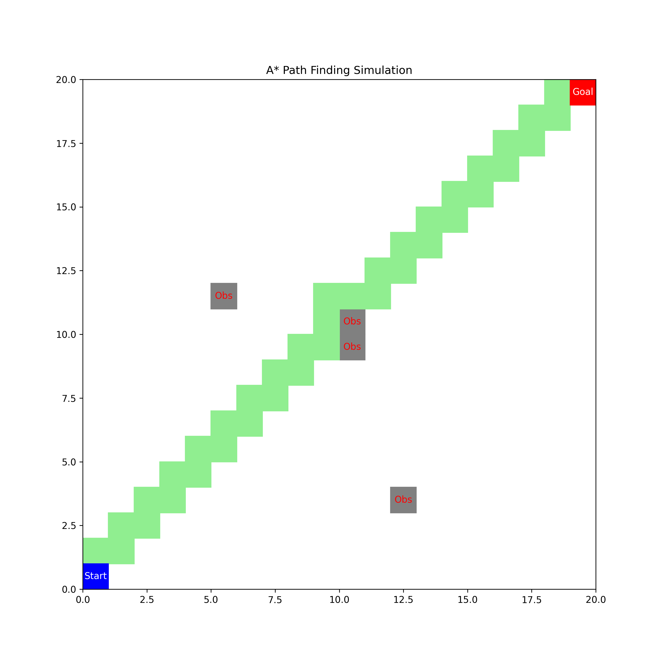
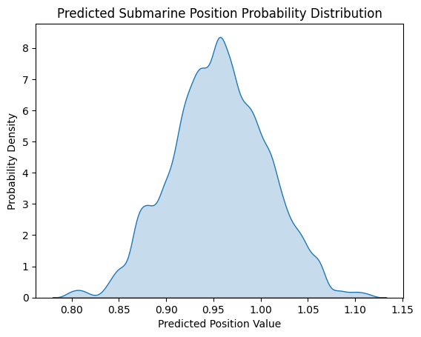
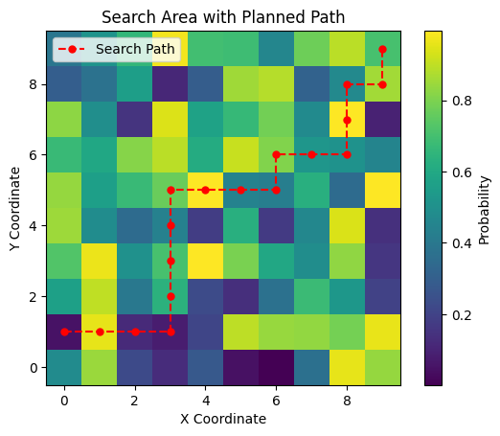

Bayesian Theory
Algorithm Process
Theoretical
Application
A Star Algorithm
Recommended Searching Path
Data Processing
Data Preview
Data Filtering
Long_Name
In-situ Seawater
Density Anomaly
Longitude
Latitude
Time
1
Latitude
360
Data
Import
Z
50
Longitude
720
Time
nv
RHOAnoma
Z
Valid_Min
-18.81316375732422
Units
kg/m³
Valid_Max
25.540061950683594

Slide 4
3. Data Association and Update
1.Detection
Hungarian Assignment
Detection Model
Detector
Matching Cascade
Mahalanobis
Distance
Matched Tracks
Input Video Sequence
REID Model
2. Predict
Cosine
Distance
IOU
Match
Unmatched
Detection
Matched Tracks
Kalman Filter
Comfirmed
Uncomfirmed
New Tracks
Update Tracking

Slide 5
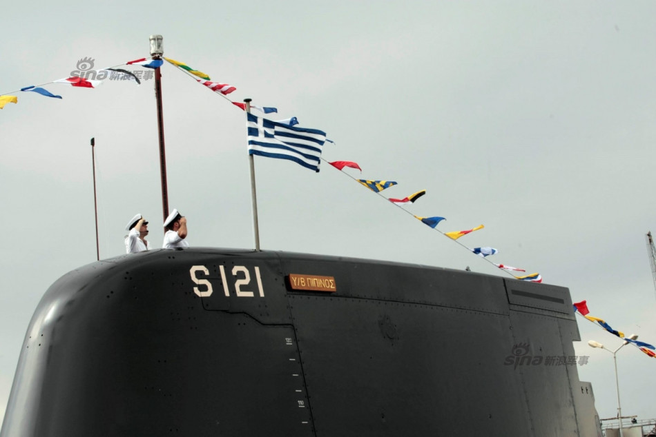
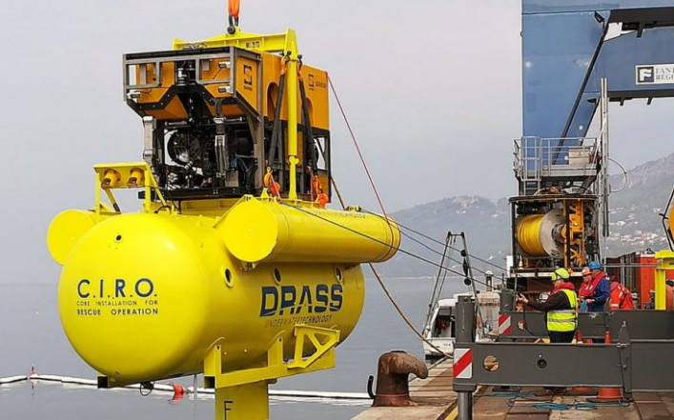
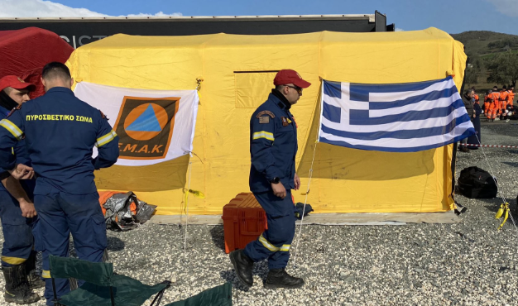
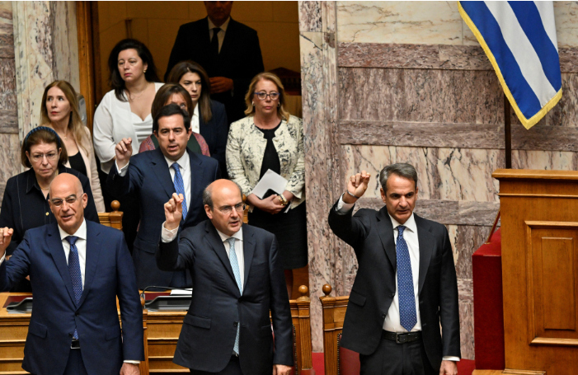
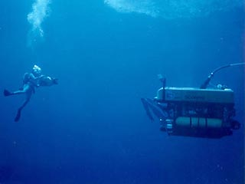
Dear Greek Marine Rescue Department:
We are writing to you with some ideas aimed at revolutionizing maritime search and rescue operations through the use of advanced predictive modeling, leveraging LSTM models and incorporating significant advancements in computational fluid dynamics. Here are the four major advantages of our model for your reference:
Dynamic Modeling
Developed dynamic predictive model integrating oceanography and physics principles, focusing on seawater density, flow, and topography to forecast mini-submarine trajectories accurately.
Innovative LSTM Integration
Employed LSTM for its proficiency in time series prediction, enhancing the model's ability to forecast future submarine positions based on historical trajectory and ocean physics data.
Enhanced Precision and Versatility
Integrated Kalman Filter for more accurate predictions by utilizing real-time data, while demonstrating adaptability to diverse maritime environments, including the Caribbean Sea.
Scalability and Proven Effectiveness
Modified for scalability, enabling simultaneous tracking of multiple submersibles and achieving high prediction accuracy, as evidenced by validations against historical data and simulations.

Slide 6
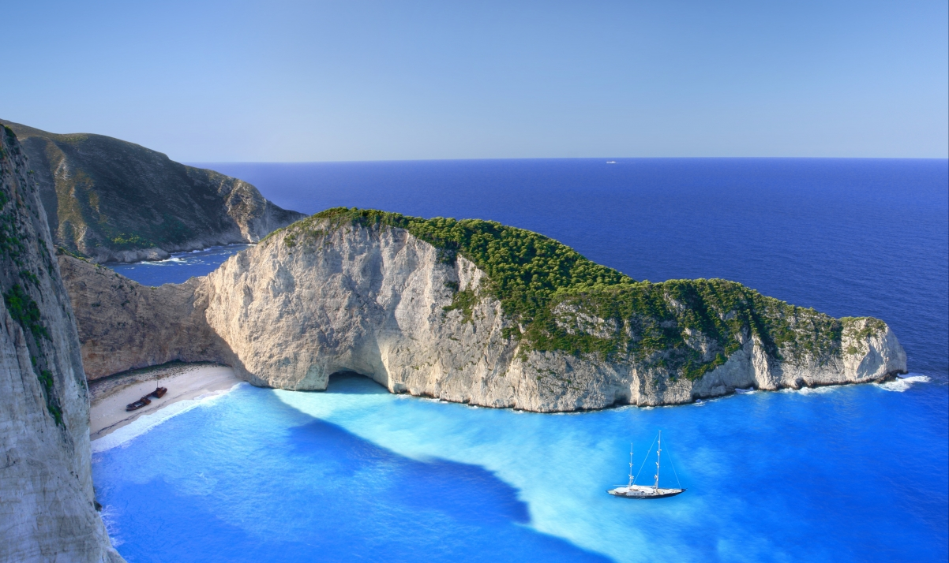
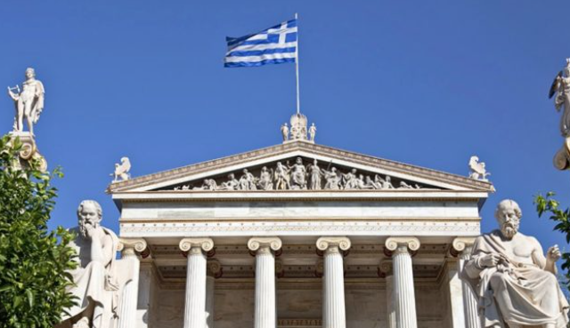
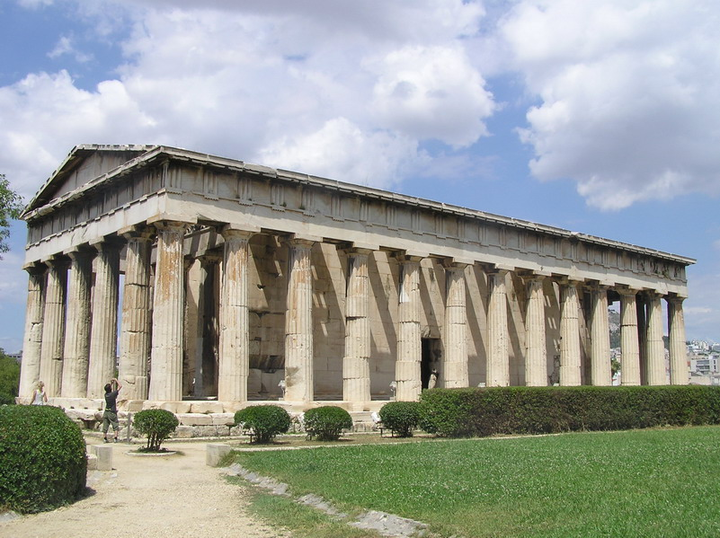

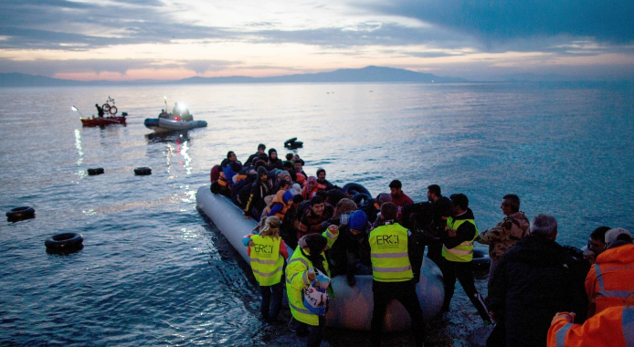
These recommendations aim to leverage technological advancements and international cooperation to safeguard lives and assets in maritime explorations. We are committed to continuous improvement and collaboration to enhance safety standards.
Best regards,
Team: 2423654
Data Integration
Improve Communication
Utilize ocean current and density data to improve predictive models for submarine trajectories.
Equip submarines with technology for continuous location and environmental data sharing, reducing uncertainties.
Versatile Equipment
Enhance Crew Preparedness
Prioritize acquisition of sonar, GPS, and ROVs for the mother ship, ensuring readiness for diverse search scenarios.
Implement training simulations based on dynamic environmental conditions, preparing crews for real-world rescue operations.
International Standards
Global Cooperation
Ensure all submarine operations meet IMO guidelines, focusing on design, operation, and emergency protocols.
Engage in partnerships for sharing data and technologies, promoting advancements in submarine safety and rescue.

